Slide 1
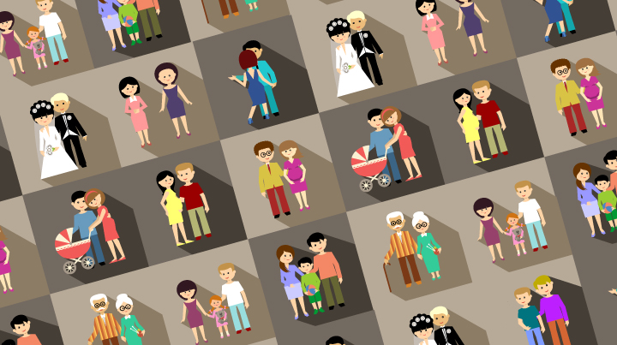
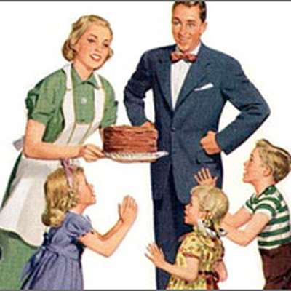


Paper 1: The sociology of Families
EX:
TG:
Date of exam:
20 May 2019
Sociology
Start time: pm
Duration: 1h 45m
Name:
Mr. Tsannos

Slide 2
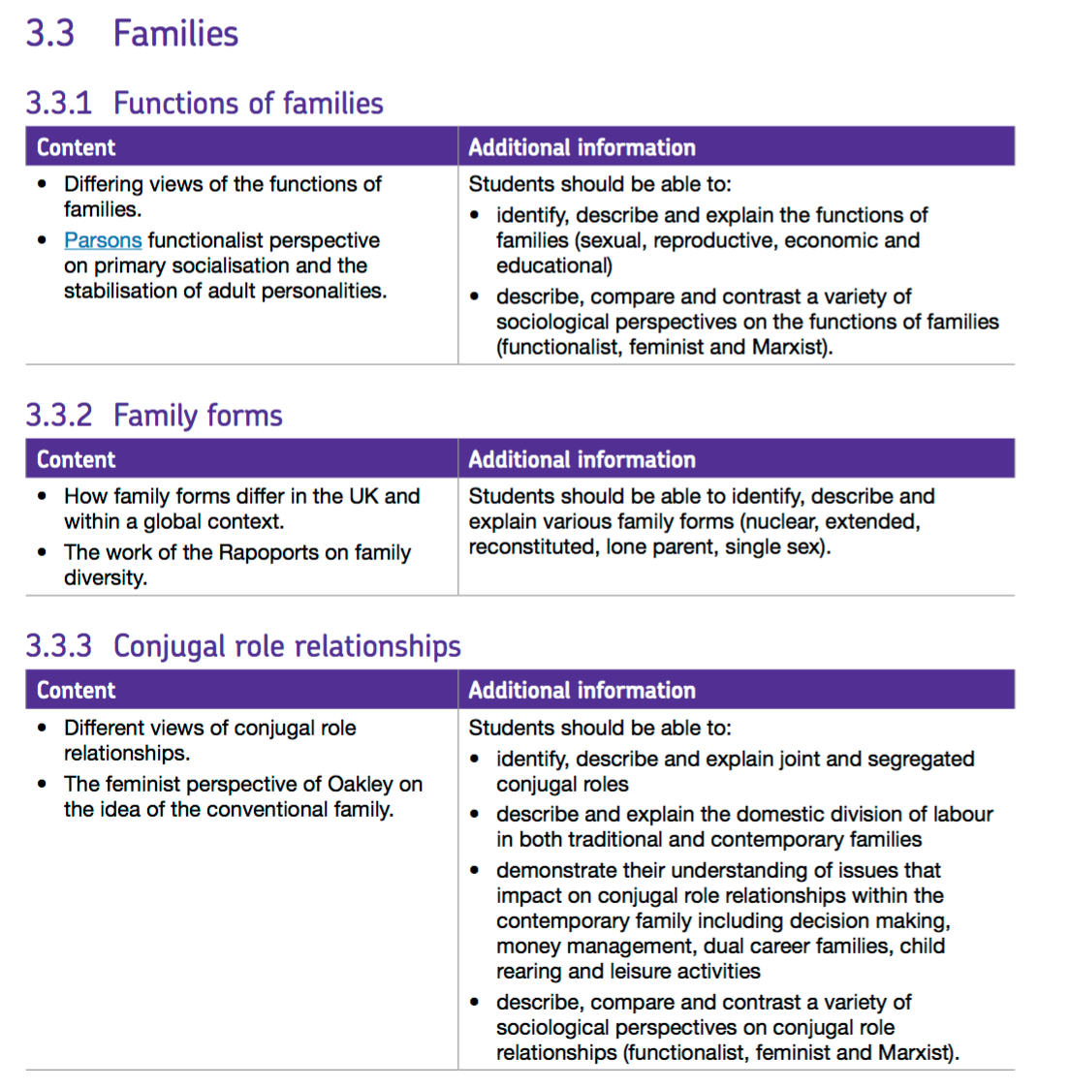
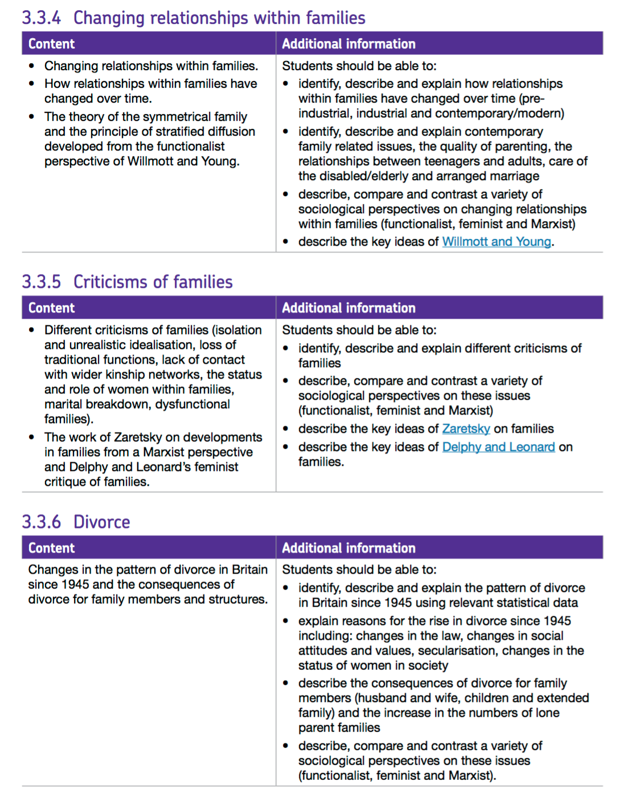

Slide 3
Functions of the family

Slide 4
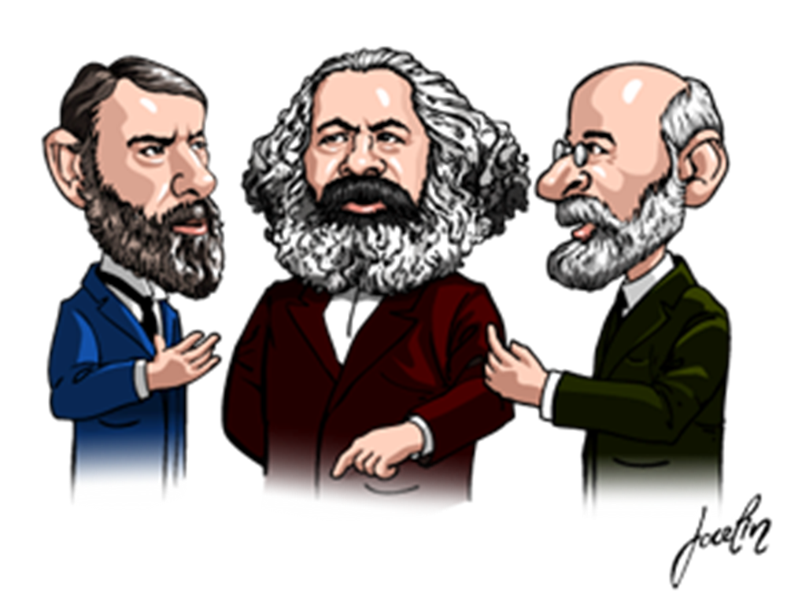


They believe the nuclear family is a key social structure in society
The family fulfils both the needs of the individual and society, and therefore helps it to run smoothly
Functionalists ignore the ‘dark side’ of the family such as child abuse
Marxists are critical of the family and its function in capitalist society
Marxists believe that the family serves the interests of capitalism
They believe that the set-up of the nuclear family enables social inequalities to continue from one generation to the next. E.g., the rich can pass down large amounts of money to their family members
They ignore families who are satisfied and happy with family life
They believe the family has a negative function, especially on the lives of women
They do not take into consideration families where there are shared conjugal roles
They have a very traditional and conservative view of the family
They believe that children brought up by both parents grow up to be stable adults
They oppose single-sex families
They do not take into consideration other family types (such as same-sex) where children receive the functions of the family
In another colour write some criticisms of each perspective
Marxist
Feminists
Functionalist
Functions of the family
New Right

Slide 5
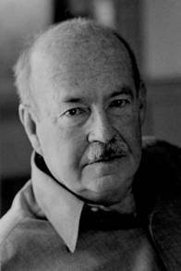
Functionalist: Functions of the family
Murdock (49)
Educational- Families teach their children the acceptable behaviour of society (socialisation). Parents, also, teach their children about their culture
Economic support- The family gives financial support, as well as food and shelter
Reproduction- The Family ensures the continuation of the human race through procreation and childbearing
Sexual- The family regulates the sexual behaviour of the couple and helps to maintain their relationship and binds them together
Parsons:
Primary socialisation:
Children learn their culture and society’s norms and values. Also, he argued that mothers perform the expressive role within the household and the father the instrumental roles
2. The stabilisation of adult personalities:
Husbands and wives can support themselves emotionally; but also can express childish elements of their own personality with their kids. This helps to keep adult personalities stable

Slide 6
Marxist: Functions of the family
Marxists seen the family as ‘consumer units’, as they buy for their family, for example, family cars houses, large televisions etc.
They believe that the set-up of the nuclear family enables social inequalities to continue from one generation to the next. E.g. the rich can pass down large amounts of money to their family members
Criticisms of the Marxist theory:
They ignore families who are satisfied and happy with family life
The approach is a bit old fashioned
They ignore family diversity

Slide 7
Feminism: Functions of the family
Marxist feminists
Marxist feminists believe that the nuclear family benefits capitalism, and therefore the rich
Men benefit more from family life than women
Radical feminists
Radical feminists believe the nuclear family mainly functions to benefit men because gender role socialisation results in boys and girls behaving in stereotypical ways
For example, the division of labour (men and women having different roles in the household)
Liberal feminists
Liberal feminists look at the increasing equality between men and women.
They campaign for changes in the law to ensure equality is recognised.
Criticisms of feminist theories:
They do not take into consideration families where there are shared conjugal roles
Marxists believe that issues in the family are based on capitalism rather than patriarchy

Slide 8
Family Forms

Slide 9
Family forms
Nuclear family creates most balanced individuals, and they believe it is good that conjugal roles are shared as it allows the family to run smoothly
In the nuclear family:
Evidence of unpaid labour and this supports capitalism as it socialises the next generation of passive workers
They believe that the nuclear family is based on patriarchy, especially in the nuclear family where conjugal roles tend to be shared
They believe the nuclear family is the most ‘natural type’ of family
They believe that children brought up by both parents grow up to be stable adults
They oppose single-sex families and value marriage
In another colour write some criticisms of each perspective
Marxist
Feminists
Functionalist
New Right

Slide 10
Different family forms
Types of Families | Description
Nuclear family | A family group consisting of parents and their children It contains two generations and family members live together Also, known as the cereal packet family
Extended family | This consists of children and other more distant relatives For example, grandparents, aunts and uncles
Reconstituted (blended) family | This is when two adults with children from previous relationships remarry (or cohabit) to form a new family This is also called a blended family
Lone Parent family | This is a family with only a mother or father as a consequence of death, divorce or individual choice
Same Sex family | These are families headed by a couple of the same sex Gay or lesbian households
Beanpole family | This is a family whose living members come from many generations, but with few members in each generation

Slide 11
Alternatives to the family
Alternative | Description
Communes | This is a group of people living together and sharing possessions and responsibilities
Kibbutz | This is a collective community in Israel that aims to provide communal living for individuals who wanted to be part of that sort of lifestyle
House share | This is a shared households The number of house shares with people aged between 35 and 44 rose by 186%
Residential homes | These are available for the elderly who struggle to look after themselves

Slide 12


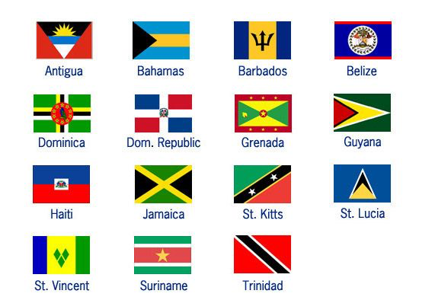
Families across the world
Country/ region | Description
China | In an attempt, by the Chinese authority, to control population growth, couples in China, who lives in cities, were restricted to just one child
South Asia (India, Pakistan and Bangladesh) | Extended family is popular in these countries
Caribbean | Caribbean families, the fathers and husbands are largely absent and women assume the most responsibility in childrearing

Slide 13
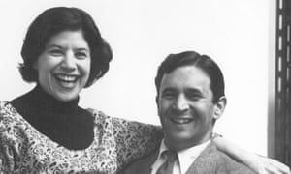
Family Diversity- Rapoports
Organisational diversity | This describes the structure of the family
Cultural diversity | Different cultures, religions and ethnic groups have different family structures, beliefs and norms and values
Social class diversity | Differences in family structure are the result of income differences between households of different classes
Life cycle (cohort) diversity | This relates to the stage in the family life cycle that a particular family has reached
Family life course diversity | Defined as older and younger generations having different attitudes and experiences that reflect the historical periods in which they have lived
Rapoport and Rapoport (1982) were some of the first sociologists to identify the increase in family diversity in the UK.
They argued the nuclear family is no longer the main type of family in society, and found five different types of diversity:
How does Chester (85) criticise the Rapoports’ research?
He believed that they exaggerated the degree of diversity in the British society
He argued that the basic features of family life have remained the same for the majority of the population since the 1950s

Slide 14
Reasons for Family Diversity
Legal Changes Divorce Reform Act (1969) Equal Pay Act (1970) Marriage (Same Sex Couples) Act (2013) | The Divorce Reform Act (1969), made it easier for couples to escape an unhappy marriage The Equal Pay Act (1970) meant that women and men doing the same job would get the same pay. The Marriage (Same Sex Couples) Act (2013) allowed same couples to get married in England and Wales
Changes in social values and attitudes | Previously, people tended to marry later and did not consider creating a family as the most important thing in their lives However, today more and more people choose to live alone, which now has less stigma attached to it than before
Changing gender roles and employment opportunities | An increasing number of women work and no longer need to depend on men for their financial security
State benefits for lone parents | The decision to divorce and raise children in a lone parent household easier to do
Longer lie expectancy | An increase in life expectancy means that when couples marry today they are likely to spend a considerable amount of their life with one person
Decline in religion (secularisation) | Secularisation refers to the declining influence of religious beliefs and institutions Goode argued that secularisation has resulted in marriage becoming less of a sacred, spiritual union and more of a personal and practical commitment
Immigration | Immigration of people from other parts of the world has led to an increase in different family types

Slide 15
Is the nuclear family still important in modern Britain?
For
Leach (67) recognised the power of the image of the nuclear family. He argued that the ‘cereal packet image of the family’ showed how families ought to be
Chester (85) nuclear family still typical family type
Huge majority of family commercials still depict the nuclear family
Functionalist perspective - emphasising the importance of the nuclear family in providing essential functions for individuals and society.
In 2016, there were 18.7 million nuclear families (still most popular)
Against
The increasing diversity of the family in contemporary society, with many people now live in other family forms e.g. lone parent, reconstituted, same-sex. (Rapoports)
Other types of family are becoming much more popular due to immigration e.g. Asian families tend to be extended families
New Right perspective - arguing that children are more likely to develop into stable adults if brought up by both parents. But due to decline of nuclear family the nuclear family is now in “crisis”

Slide 16
Conjugal role relationships

Slide 17
There are segregated roles in society because it is ‘natural’.
Men and women simply have naturally different roles and that both are needed for the family to run smoothly
Parsons, believed that working life can be stressful and the family is the place where adults can de-stress, which reduces conflict in society. This is called the ‘warm bath’ theory
They ignore conflict within the family e.g. husband and wives unhappy with their roles
They believe that men and women have different roles because that structure supports capitalism
Zaretsky believes that the family supports capitalism by providing unpaid labour
Marxism ignores the benefits of a nuclear family, for example, both parents supporting their children
Present day Feminists, talk about ‘Triple Shift’ of women, 1. Career. 2. Housework. 3. Emotional work (Support family)
Feminist Ann Oakley (74) identified the existence of strong segregated roles. She said women tend to do all the housework.
What is Delphy and Leonard believe it is men, who benefit the most from women’s labour. They believe the family is maintains patriarchy
Functionalists would argue that feminists put too much emphasis on the negative side of family life because it ignores the possibility that women enjoy running the home, being married and raising children
Similar to Functionalists they believe that segregated roles in the nuclear family are the best way for a family to function
They tend to have a very negative view of lone- parent families and do not take into account one- parent families who thrive and contribute to society
In another colour write some criticisms of each perspective
Marxist
Feminists
Functionalist
Conjugal role relationships
New Right

Slide 18
Conjugal roles
Conjugal roles = roles within a marriage. Bott (71) identified 2 types
 | Segregated conjugal roles | Joint conjugal roles
Definition | This is where the husband and wife perform different and clearly defined activities, | This is where husbands and wives share household tasks
Roles within the household | The mother may cook and clean while the husband may go out and work | Both partners are likely to be in pair work. With household tasks being shared
Statistics | A study of households in 34 countries found that there was no modern country where men did more housework than women | Research has found that men ARE taking on more household roles…. BUT these are more masculine jobs e.g. DIY

Slide 19
Ann Oakley 1982 x
LIBERAL
Her work focused on the conventional family (which was the nuclear family)
She said that women are expected to do unpaid work inside the home while men are expected to do paid work outside the home
Men have economic power within the family because of the paid work they do outside the home
Women therefore depend on men’s wages and this is an aspect of inequality in the family
However, she notes that conventional family stereotypes are increasingly seen as dated and some groups are looking towards alternative ways of living
Criticism of Oakley’s view on conjugal roles
She failed to study any other factors e.g. ethnicity or class

Slide 20
Ann Oakley 1974
LIBERAL
Research method:
40 married women were interviewed
Results:
70% of women interviewed were ‘dissatisfied’ with the housework
Only 25% of husbands had a high level of participation in childcare
Only 15% of husbands had a high level of participation in housework
Conclusion:
There was no evidence of shared conjugal roles
Criticism of Oakley’s view on conjugal roles
There was not a big sample… results are hard to generalise to a wider society

Slide 21
Key concepts in conjugal roles
Key concept | Sociologist | Definition
Dual Burden | OAKLEY (74) | According to Oakley, this is when women are in paid work but also perform the bulk of the domestic work
Triple shift | DUNCOMBE (95) | This refers to three types of work performed by women Paid work, domestic work and emotional work
Domestic division of labour | N/A | These are household tasks divided between family members

Slide 22
Conjugal roles: Studies on changing relationships within families
Edgell (1980)
Pahl (05/08)
Aim: Look at decision making in the home
Research method: Interviewed middle- class couples
Results: Men held decision making responsibilities in important areas; women in unimportant areas
Aim: Decision making in the family, including decision on money, going on holiday etc…
Results: Money management responsibility was with the one who earned the most money

Slide 23
Changing relationships within families

Slide 24
They believe that today the family has lost many of its functions
For example, the function of emotional support can now be seen to be taken on by the education system and various welfare systems
They believe that today the family has lost many of its functions-
For example, the function of emotional support can now be seen to be taken on by the education system and various welfare systems
The rich and business owner use the family as a way to create demand to sell their good
This happens by families constantly comparing themselves to others around them in terms of having consumer goods
The rich and business owner use the family as a way to create demand to sell their good
This happens by families constantly comparing themselves to others around them in terms of having consumer goods
Some feminists believe more equality has been gained in the family; however other feminists disagree
Those who disagree for example, believe that even though men may help out more often at home. On the whole women still carry the burden of the triple shift
They believe that family values are declining and this has put the family in crisis
Some feminists believe more equality has been gained in the family; however other feminists disagree
Those who disagree for example, believe that even though men may help out more often at home. On the whole women still carry the burden of the triple shift
They believe that family values are declining and this has put the family in crisis
In another colour write some criticisms of each perspective
Marxist
Feminists
Functionalist
Changing relationships within families
New Right

Slide 25
Young and Willmott 1973
Functionalist
perspective
Identified four stages of family life:
Stage 1: The pre-industrial family
Stage 2: Early industrial family
Stage 3: The symmetrical / privatised nuclear family
Emerged in middle classes but spread into and common in working classes, reflecting the boring and repetitive nature of paid manual jobs leading to more focus on home life
Nuclear family at he expense of extended family; home centred and privatised; more time spent with family
Symmetrical roles – less segregated, more equal – household chores and decisions; not interchangeable but equally important
Reasons for rise in symmetrical family:
Improved living standards
Increasing geographical mobility
Reduction in the number of children in the family
Commercialisation of housework
Improved status of women
Stage 4: The asymmetrical family
Principle of stratified diffusion –
This is the idea that social changes start at the top of the social stratification system and spread downwards
For example, changes in family life spread from the middle class into the working class
Interviewed sample of nearly 2000 people in Greater London and surrounding areas
CONSENSUS

Slide 26
Changes in family relationships over time
 | Type of family | Family roles
Pre-Industrial Family | Extended family | Father as head of household, exercising economic control over family The family need a lot of family members to help them with the family’s work Family was the main unit of production producing most of the goods for the families survival
Industrial Family | Nuclear family | This family emphasised the women's role as "mother" and domestic labourer
Contemporary/ Modern Family | Nuclear family, however, because of the huge amount of diversity in the UK there are many different types of family | Women and men’s role in the family became more equal. Partners carry out different tasks but each makes similar contribution to the family (symmetrical family)

Slide 27
Criticisms of the family

Slide 28
Criticisms of the family
Criticism | Explanation and elaboration
Loss of traditional functions (New Right view) | With the rise of cohabitation, lone-parent homes and same-sex families they believe families are unable to offer and deliver the traditional and balanced functions of the family
Lack of contact with wider kinship networks | Some family members especially the elderly are now outcasts in the family Increasing geographical mobility and women’s involvement in full-time work have meant that family members see each other less often
The status and role of women within families | Despite changes in women’s roles, feminists still believe that the family has a negative impact on women. For example, in the past they were expected to take part in a double shift; with the inclusion of work they now take part in a triple shift
Dysfunctional families | Some members of the family can be harmed by family life, this is called, ‘the dark side of the family’. Within these families domestic violence, child abuse and elder abuse can take place The home can become a place of fear rather than somewhere that people feel safe and loved

Slide 29
Delphy and Leonard 1992 -
Feminist
perspective
In their view it is men, who benefit the most from women’s labour
The family plays a major role in maintaining and reinforcing patriarchy
Family is an economic system involving a division of labour which exploits women but benefits men
Women are oppressed as their work is adopted within the family
For example, women may be employed outside the home but still expected to do domestic chores when they get home – work is not share equally with their male partners
RADICAL

Slide 30

Zaretsky 1976
Marxist
perspective
The Marxist Zaretsky believes that the family supports capitalism by providing unpaid labour, reproducing a new labour force and being a unit of consumption
Zaretsky also claims that the family allows individuals to express their frustrations with capitalism in a non-threatening way
The family supports the capitalist economy:
It relies on the housewife role as unpaid labour and reproducing the next generation of workers
It acts as an vital unit of consumption

Slide 31
Divorce

Slide 32
Functionalists would explain divorce by identifying the beneficial results to both the individuals involved and to the society
For example, we would end up with a happier society and fewer dysfunctional families
Marxists would describe divorce as the competition for resources and power within the marriage where both parties cannot come to an agreement
Unequal access to resources in society can lead to tension within families. This could explain the higher rate of divorces among the working classes
Feminists believe that divorce now allows women to leave unhappy marriages whereas before divorce was legal they would have had to remain in unhappy marriages
Blame the decline of marriage on moral decline – part of the broader breakdown of social institutions and due to too much acceptance of diversity.
This results in the inability of people to commit to each other, and they see this as bad for society and the socialisation of the next generation.
In another colour write some criticisms of each perspective
Marxist
Feminists
Functionalist
Divorce
New Right

Slide 33
Marriage and Divorce
Trends in Marriage
Trends in Divorce
Official statistics show that there has been a decline in the number of marriages
Marriages in the UK peaked in 1972 at 480 000. Since then, the overall number of marriages has fallen and in 2011 there were just over 286 000 marriages
Compared with the early 1970s, people are now putting off marriage until they are older
In general, the number of divorces per year is going up, although there has been decreases
In 1970 there was 63 000, in 1993 there were 180,000 and in 2005 there were 155,000

Slide 34
Factors effecting marriage
Factor | Explanation
Changing role of women | Today women are much more independent economically and therefore they have much more choice and say in their relationship choices. Women they have ;less need for the financial security of marriage and support from men
Changing social attitudes | This is linked to increased educational and employment opportunities, especially for women It is also related to changing social attitudes towards premarital sex
Increase in cohabitation | Some people cohabitate without expecting the relationship to develop into a long-term one. For others, it is a long-term thing The increase in cohabitation on the whole is based on the changing attitudes towards sex outside of marriage post-1950s.
Secularisation | Due to the decline in the importance of religion in the UK, marriage is not as fundamental to UK life. Less than a third of marriages involve a religious ceremony
Rising divorce rates | Many people choose not to marry in the light of the rising divorce rates
Expense of marriage | The high cost of marriage and the high costs of saving for a mortgage may put people of marriage

Slide 35
Divorce
Legal changes | Legal changes have made divorce easier, quicker and cheaper than in the past The Divorce Reform Act (1969) in England and Wales played a big role in this. Legislation in 1984 (Divorce Law) allowed couples to request for divorce after only one year of marriage, rather than three
Changing social attitudes | Since the 60s divorce has become less stigmatized and more socially acceptable For example, members of the Royal Family have divorced and in the media, we often hear of celebrities divorcing
Secularisation | This means that less people are getting married in churches As, a result the religious barrier to divorce is weaker today than it was in the past
Changing role of women | Today, women participate more in the labour market and are now more independent The availability of welfare benefits allows women not to be poor after a divorce. They can apply to a variety of state benefits that can support their family
Media | The popular media (magazines, pop music and soap operas) tend to emphasise the importance of mutual attraction and ‘romantic love’ relationships. Consequently, individuals may have high expectations of marriage

Slide 36
Divorce
Consequences of divorce | Impact on family members
Consequences of divorce for husbands and wives | Emotional effects of a divorce, for example, grief and loneliness Legal aspects relating to a divorce, for example, courts, custody of children Economic aspects of a divorce, for example, less money
Consequences of divorce for the family | The increase in divorce has led to an increase in lone-parent and reconstituted families
Consequences of divorce for children | Divorce leads to children having to spend time with parents separately and can often require adjustments to new sets of relationships in reconstituted families
Consequences of divorce for the extended family | Grandparents may not see their grandchildren and in other situations they might be required to help out in the home and with childcare

