Slide 1
Next Steps and UCAS
Welcome Parents and Year 12!

Slide 2
Year 12: A Reflection
Year 12 is over and Year 13 has begun!
Everything that is to come relies on hard work NOW to bring success – you need to continue being proactive
Start thinking about long term goals

Slide 3
Life After Sixth Form - Your Options
University
Workplace
Gap Year
Apprenticeship

Slide 4
Timeline
Personal statement workshop
Completing personal statement
First applications submitted
BMAT (BioMedical Admissions Test) has been scrapped for 2024 admissions.
19th Sept – UCAT registration deadline
26th Sept – UCAT Last test date
Deadline for all UCAS applications
Apprenticeships to follow (Jan)
UCAS launch day (enrichment)
Abbeyfield Careers Fair
MARCH
Attended Leicester UCAS and Apprenticeship fair to explore future options
JULY
DEC
SEPT
JUNE
AUG
OCT
Attended next steps evening!
Careers interviews.
Tutor times – Exploring options and making decisions
University of Leicester taster day – more info to follow!
Exploring options
Making final decisions
University open days
Doing things for personal statement!
Tues 15th – Application deadline for medical and Oxbridge students
*Other courses may have extra admissions tests but this will clearly be stated on course information and support will be provided from the sixth form team

Slide 5
University Colleges Admission Service
www.ucas.com

Slide 6
The UCAS application process
Registering (we will do this on the launch day in July)
Decisions / Open days / Gaining experience
Personal information completed
Personal Statements
References – 2024 changes
Checking
Payment and submission (£28.50 multiple courses ) – No application fee if you receive free school meals or the bursary
Interviews / Auditions
Offers
Results day / Clearing
All students will be provided with a UCAS Step by Step guide to work through independently. Students will also meet with Mrs Wawrzesta 121 before submitting their final application

Slide 7

References
What does this mean for you?
- Stronger focus on personal statement and predicted grades to support your application.

Slide 8
Entry Grades Data
Historic entry grades data is currently a feature within the adviser portal that shares course-level information about student grades upon entry into higher education.
Entry grades data will be available on course details pages in our search tool.
Many students found this motivating and informative.
In conjunction with undergraduate applications opening for 2025 entry, students will see the grade profiles of students accepted onto courses, alongside offer rates.
Additionally, they will have the opportunity to add their predicted grades to contextualise the historic information to them.

Slide 9
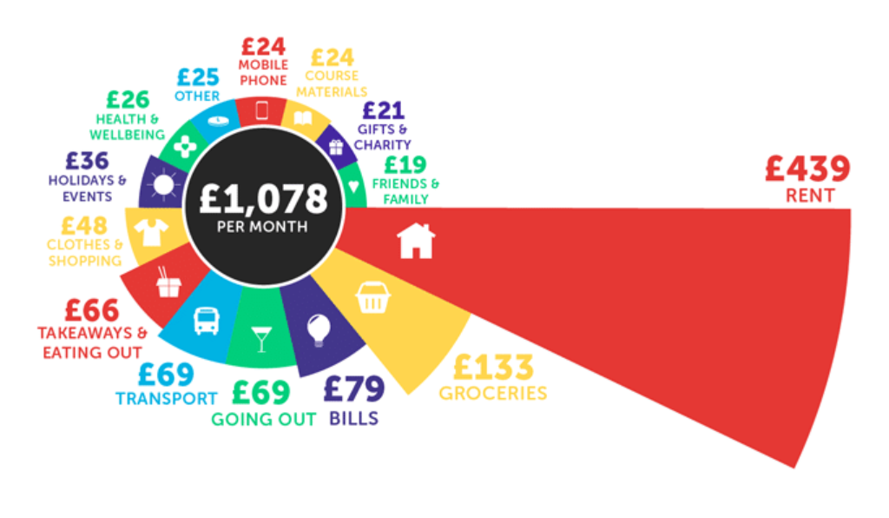
Cost of University
Average total cost of going to university:
£66,560
(including tuition fees)
Average monthly cost (according to savethestudent.org)

Slide 10
Student Loans/Grants etc.
Tuition fee loan: most students will be eligible. International students will not have access to this.
Maintenance loan: helps with living costs.
Special support grant: Helps with day to day costs when you study if your household income is under £41,065
Travel grant: If your course means that you may live abroad for a portion of it
Disabled student’s allowance: helps cover any additional costs that you might need to pay out when going to university
Student bursaries: Check eligibility online
NHS Bursary: Read up online as there are lots of different ones!
Practice Placement Expenses; Helps with travel when your placement is not at your university etc.
Savethestudent.org/student-finance

Slide 11
Point Scores
A Level points
Grade | Point score
A* | 56
A | 48
B | 40
C | 32
D | 24
E | 16
EPQ
Grade | Point score
A | 28
B | 20
C | 16
D | 12
E | 8
Core Maths
Grade | Point score
A | 20
B | 16
C | 12
D | 10
E | 6

Slide 12

Getting experience to STAND OUT
Community Service
Regular sports or fitness activities / teams
Events and productions
Part time job
Volunteering
Work Experience
Babysitting / Caring for others
EPQ – area of research
Guides / Scouts / Duke of Edinburgh
Competitive participation at local, national or international level
Blogs or vlogs – your own or those you subscribe to regularly
Subscription to a magazine or journal in your chosen area, for example The Economist or The Stage

Slide 13
A short task…
Parents – Write five to ten things, on separate sticky notes, that SELL your son/daughter’s best qualities or experiences
Students – Write five to ten things that YOU think are YOUR best qualities or experiences
What makes you stand out? NOW is the time! (Think about volunteering, wider reading, work experience etc)

Slide 14
Alternatives to university
Apprenticeships
Workplaces
Gap year

Slide 15
Apprenticeships
What they are and where to find them

Slide 16
Apprenticeships
Not the same as when I was young
  Higher Level
  A wide range of professions including accountancy, law, banking, digital marketing (All of these are currently available within 20 miles of this area)
  Qualifications are usually part of the course
  You get paid rather than paying!

Slide 17
Apprenticeships
Who are they best suited for?
  Someone who knows exactly what they want to do.
  Someone who is able to travel
  Someone who does not like the idea of continuing in education (but would rather learn in a practical setting)

Slide 18
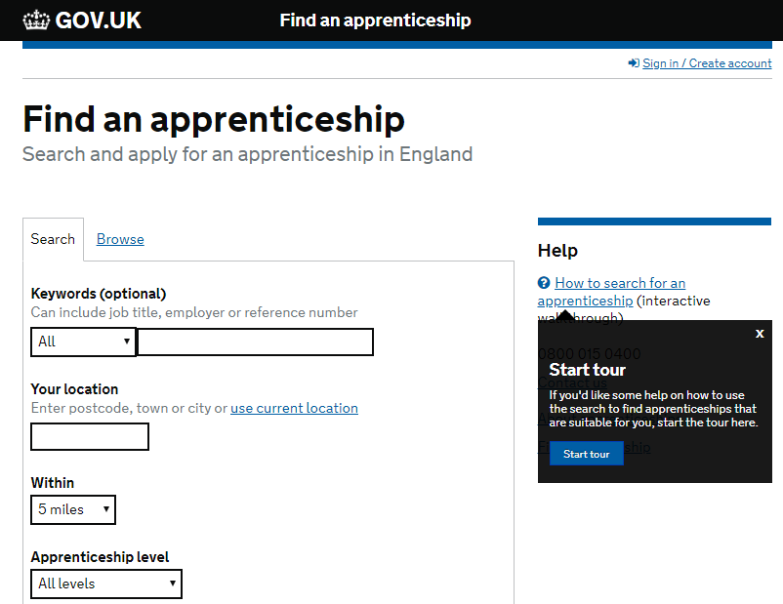
Apprenticeships – where to find them
https://www.findapprenticeship.service.gov.uk/apprenticeshipsearch

Slide 19
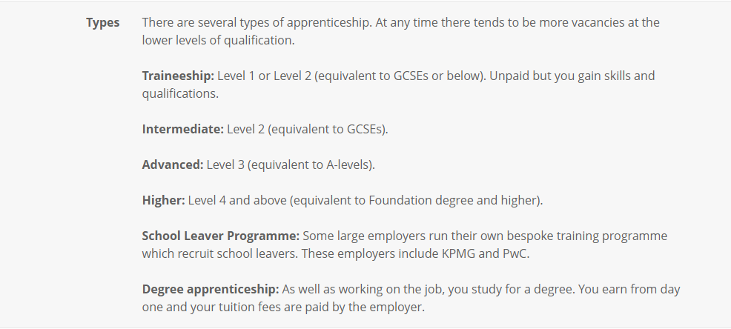
Different types of Apprenticeships
KPMG = Auditing / Tax services
PwC = Accounting, Business, Technology or Data services

Slide 20
Employment
Completed with education
Student leaver / entry level positions
Salary (may be appealing initially – what progression is available?)
Banking – Barclaycard and Nationwide provide a range of customer service and office based positions with career progression.
Logistics – There are numerous opportunities within this sector in Northampton too, including some with large local companies such as C Butt Logistics, Loop Logistics etc.
Retail – management programmes

Slide 21
Gap Year
Advantages | Disadvantages
Go travelling – learn new cultures, new languages, experiences | You’ll be a year behind your friends
You’ll meet new people | It can be stressful – finding employment, earning money, booking holidays – sorting out travel insurance, visas etc
You’ll become more mature (you experience new ideas, experiences and situations) | Potential to waste a lot of time – it won’t just happen / a lot of planning and organisation needs to take place
It’s a break from traditional education – learn about real life situations, really consider what the right course/step is for you | You’re no longer a student – it can be a big deal / shock into real life
You get to look after yourself | Expensive!
https://www.gapyear.com/
https://www.ucas.com/alternatives/gap-year/gap-years-ideas-and-things-think-about
https://www.gooverseas.com/blog/what-to-do-on-gap-year

Slide 22
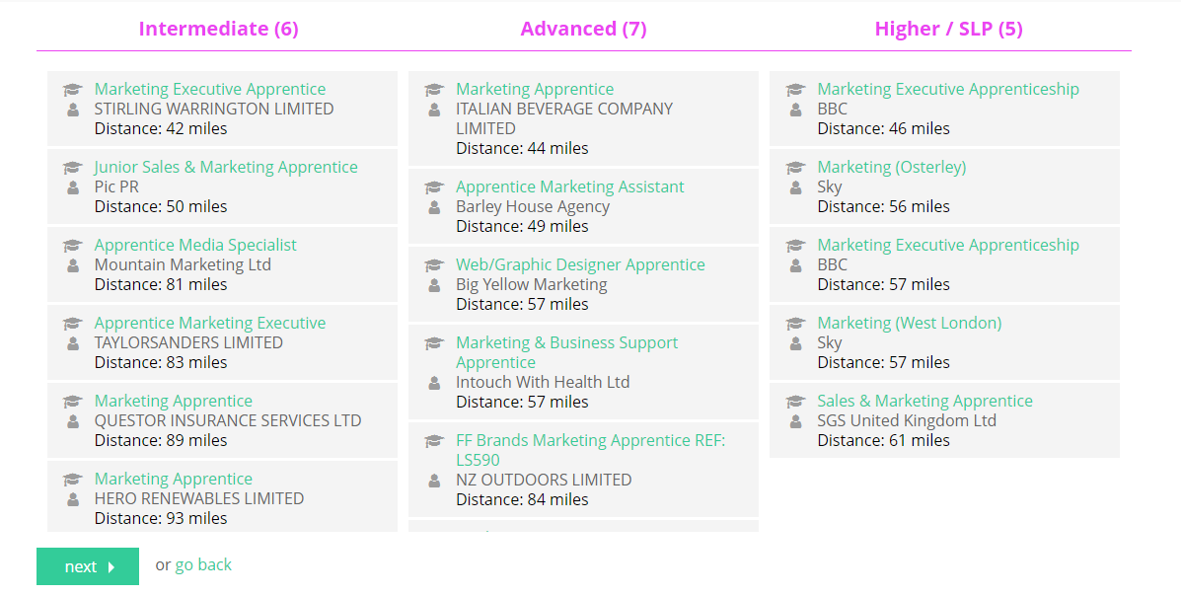
Accessing UniFrog - Apprenticeships
Example: Advertising and Marketing apprenticeships available

Slide 23
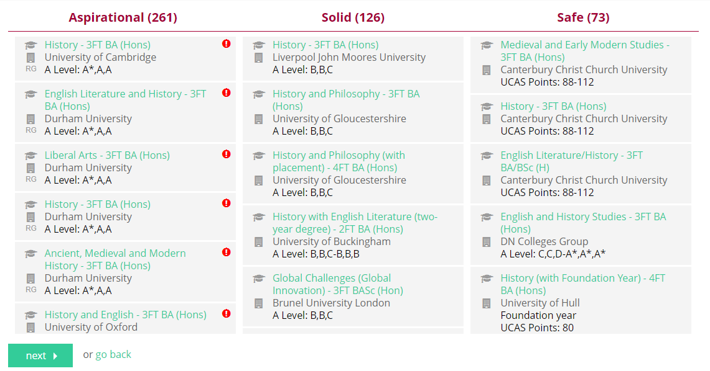
Accessing UniFrog – University options
Enter your predicted A Level grades – Choose the subjects that interest you
Eg: History > History and English / History and Philosophy / Business Management & History

Slide 24
Students
Be proactive
Do your research now
Make the time
Speak to parents, form tutors, sixth form team
Speak to family
Attend open days
Where do you want to spend the next few years which will ultimately shape your future?

Slide 25
Parents
Attendance
Encouraging activities and experiences that will support the next steps
Ensuring productive work time with a quiet space and lots of encouragement as well as checking revision / study plans
Encouraging clear routines, including rest
Questioning / discussion and exploring options with your son or daughter
Open days
Looking at the application form with your son or daughter

Slide 26
Useful information
Deadlines
End of Summer term | Registered for UCAS, started to look at courses and make decisions
Fri 20th September | Personal statement completed
Tuesday 15th October | Application deadline for Oxbridge and all Medicine courses
Thursday 5th December | All UCAS applications submitted
Useful websites to check out
www.opendays.com www.ucas.com www.gapyear.com
www.aimhighernorthamptonshire.co.uk https://www.unifrog.org
https://www.gov.uk/topic/further-education-skills/apprenticeships

