Slide 1




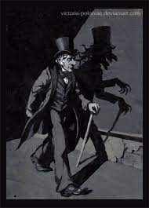




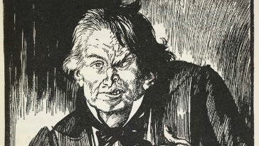
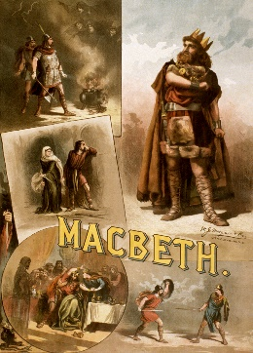


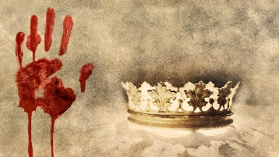






Year 10 English – Learning Journey
EXTENDING
Term1
JEKYLL AND HYDE
Term
2
20TH CENTURY PROSE
NON-FICTION TEXTS
Term 3
MACBETH
Term 4
Term 5
NARRATIVE AND DESCRIPTIVE WRITING
Term 6
SPOKEN LANGUAGE

