Slide 1





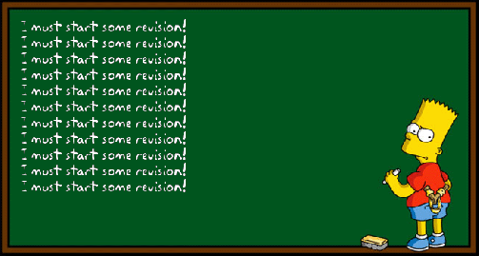
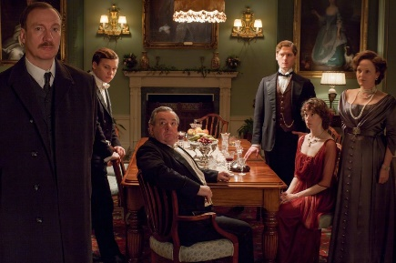



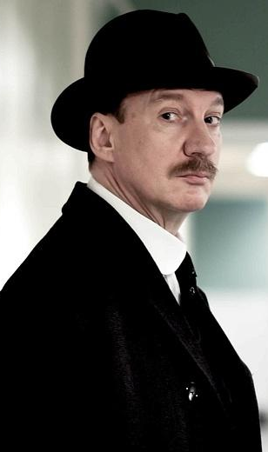

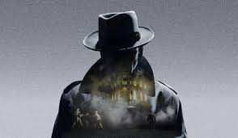




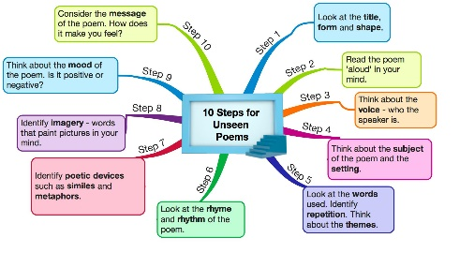




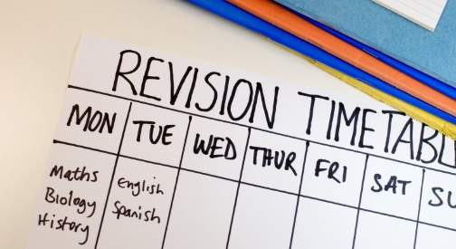
Year 11 English – Learning Journey
EXCELLING
Term1
AN INSPECTOR CALLS
Term
2
PPE REVISION
UNSEEN POETRY
Term 3
LOVE AND RELATIONSHIPS POETRY
Term 4
Term 5
EXAM REVISION
Term 6
EXAMS

